Slide 1
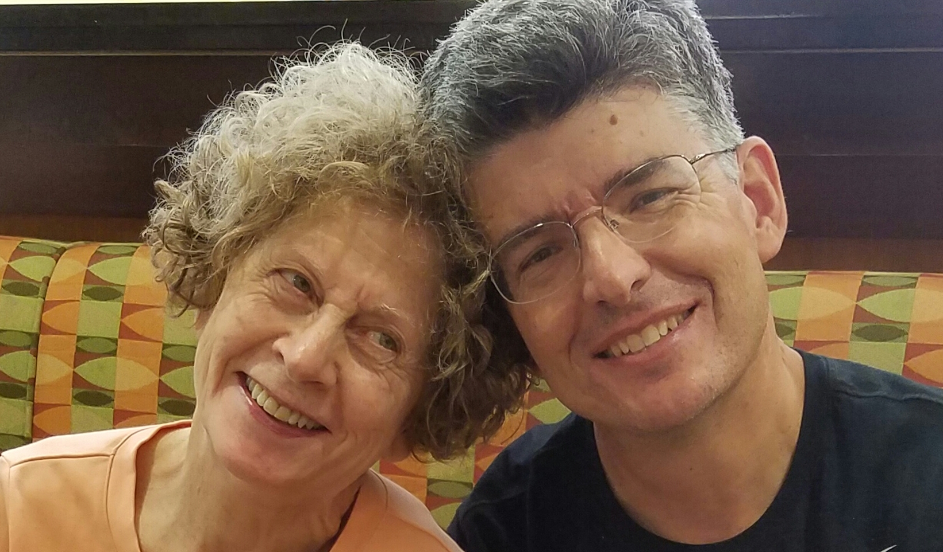
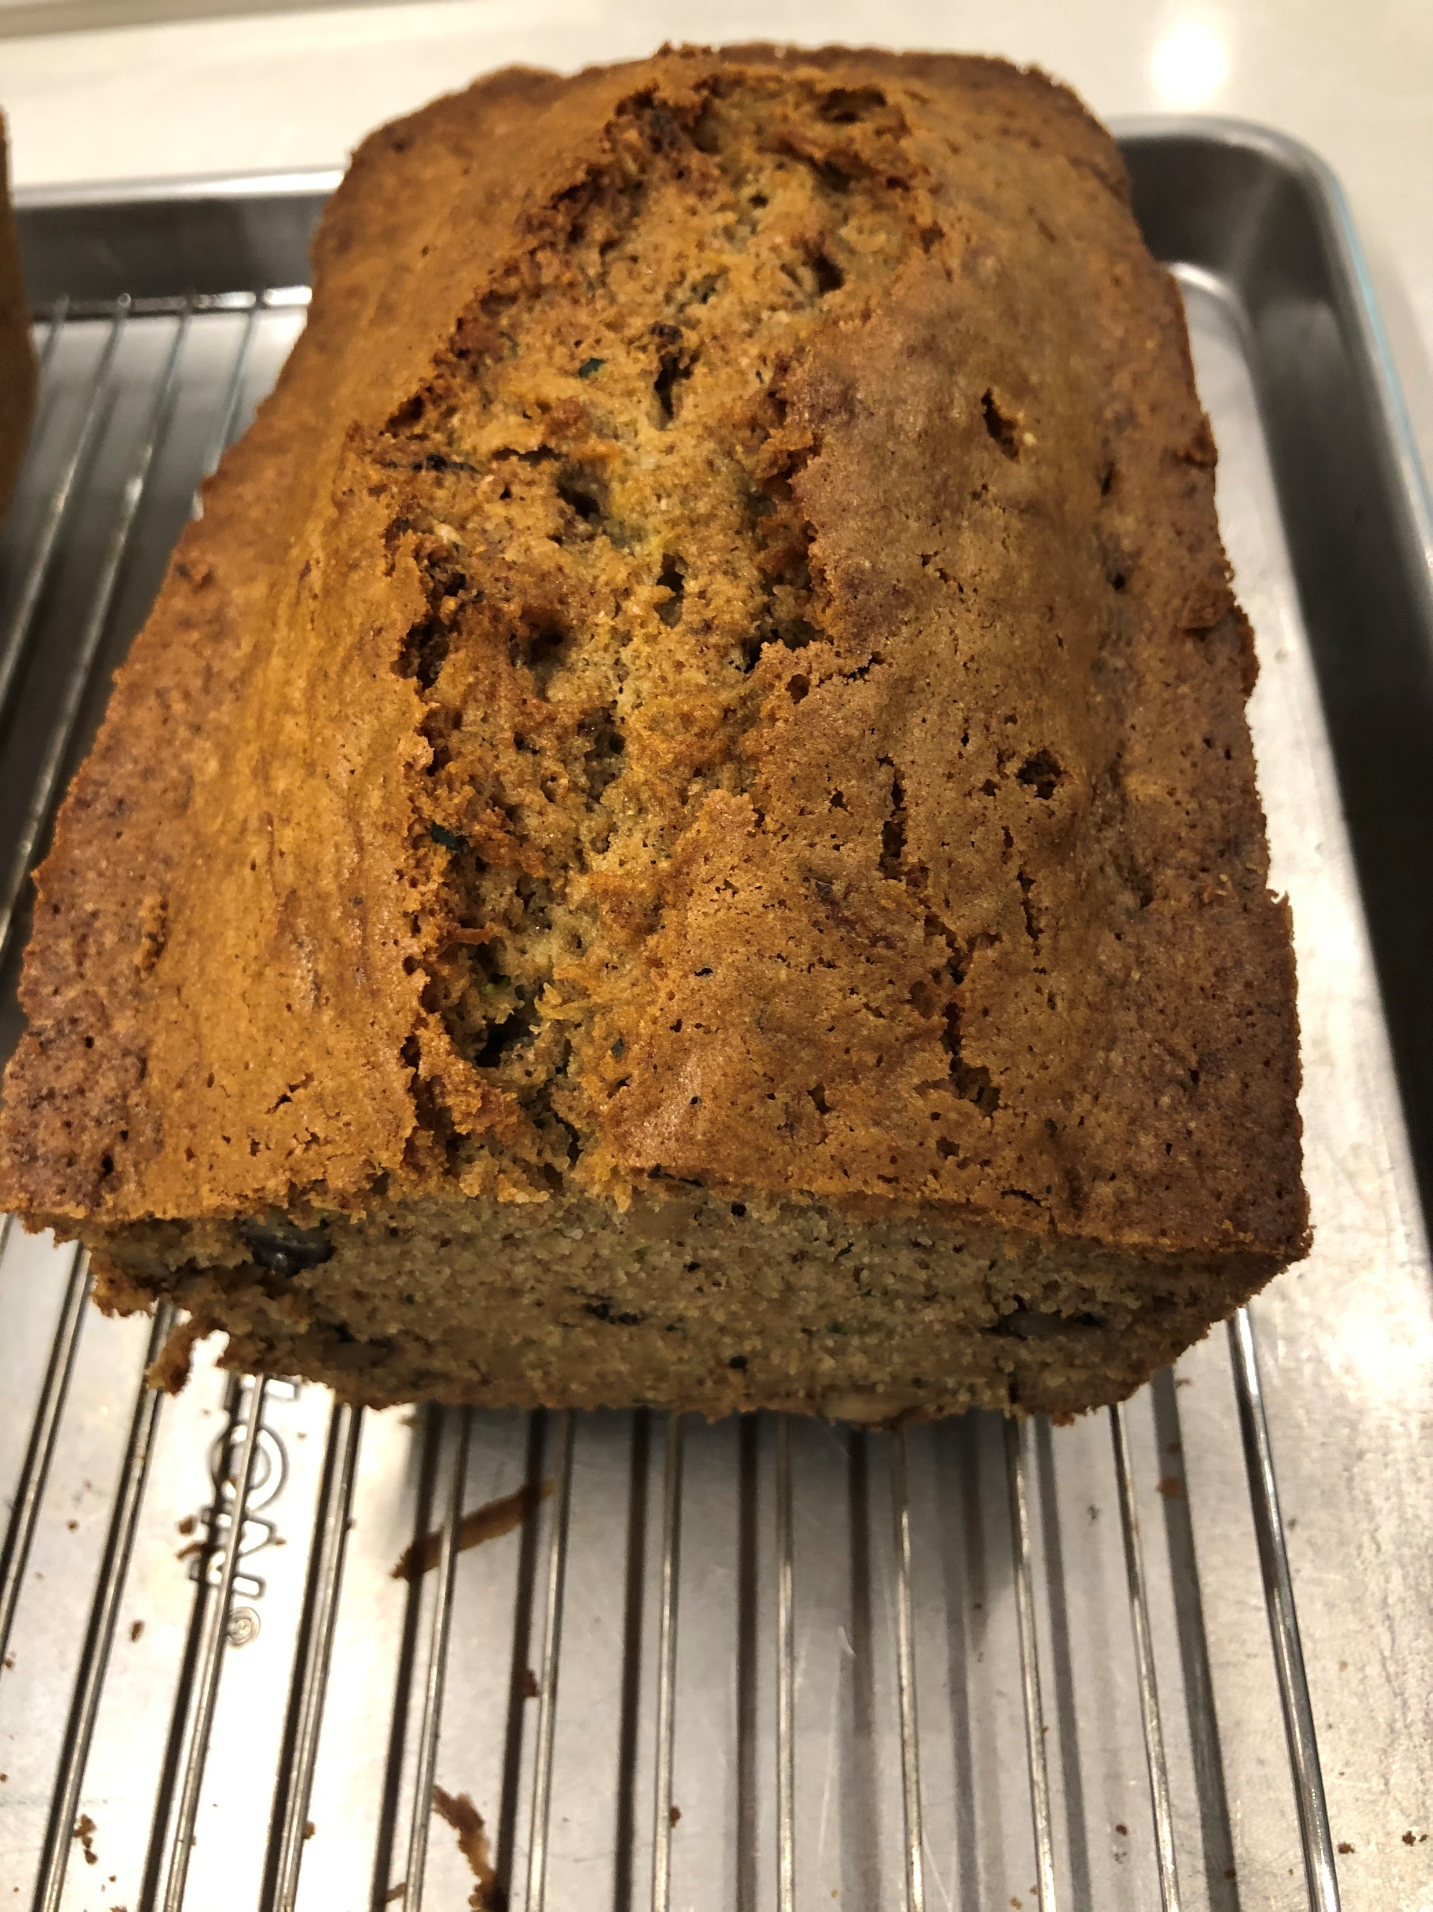
A year+ without Mom

Slide 2
6/18/20
It's hard to believe it's been a year since mom's passing. I can remember it like it was yesterday, and while thinking about it brings sadness, mom would want us to think back to all the wonderful memories we had together. From playing with toys by her feet when we were young, to building snow forts, and then migrating to those special 1-1 times she cherished so much with each of us as we got older and moved on with our lives. She is no doubt still looking down on us today and still wanting the best for us - and for us to enjoy life to the fullest as she always did.
With this in mind and with my dearest wife Tamara loving support, we are honoring her today in part by having some home-made Zucchini bread, complete with strawberry rhubard jam as it's meant to be eaten. While I would love to send each of you some, that's really impractical. Thus, I've decided to go the extra mile and eat a piece for each of you! Take my word for it - it's quite delicious. I'm sure it puts a smile on mom's face as well, knowing "her boys" as still "together", if not in person at least in spirit.

Slide 3
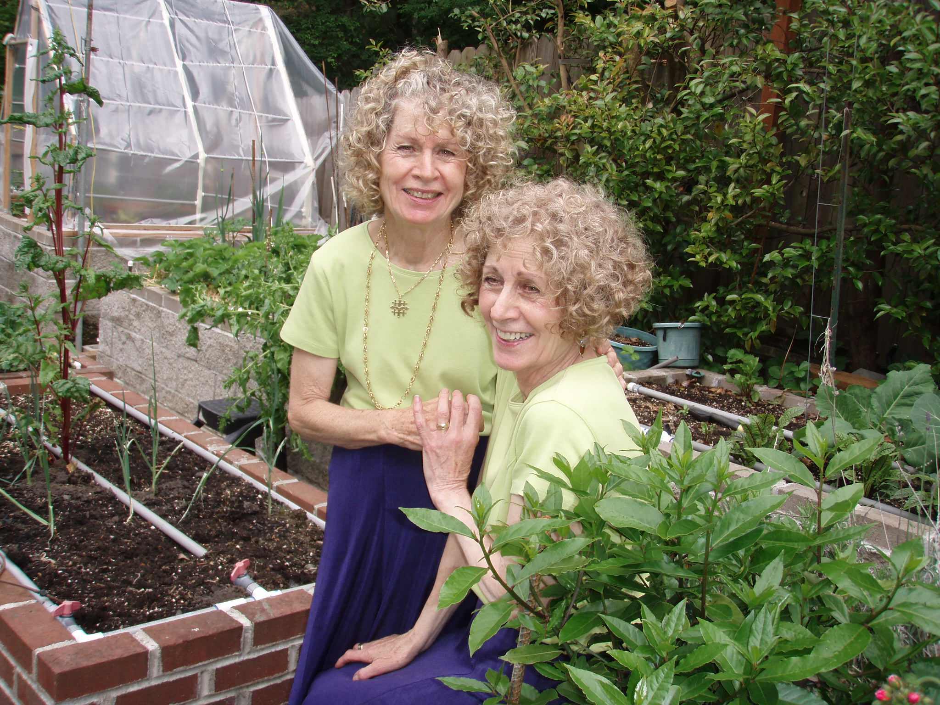
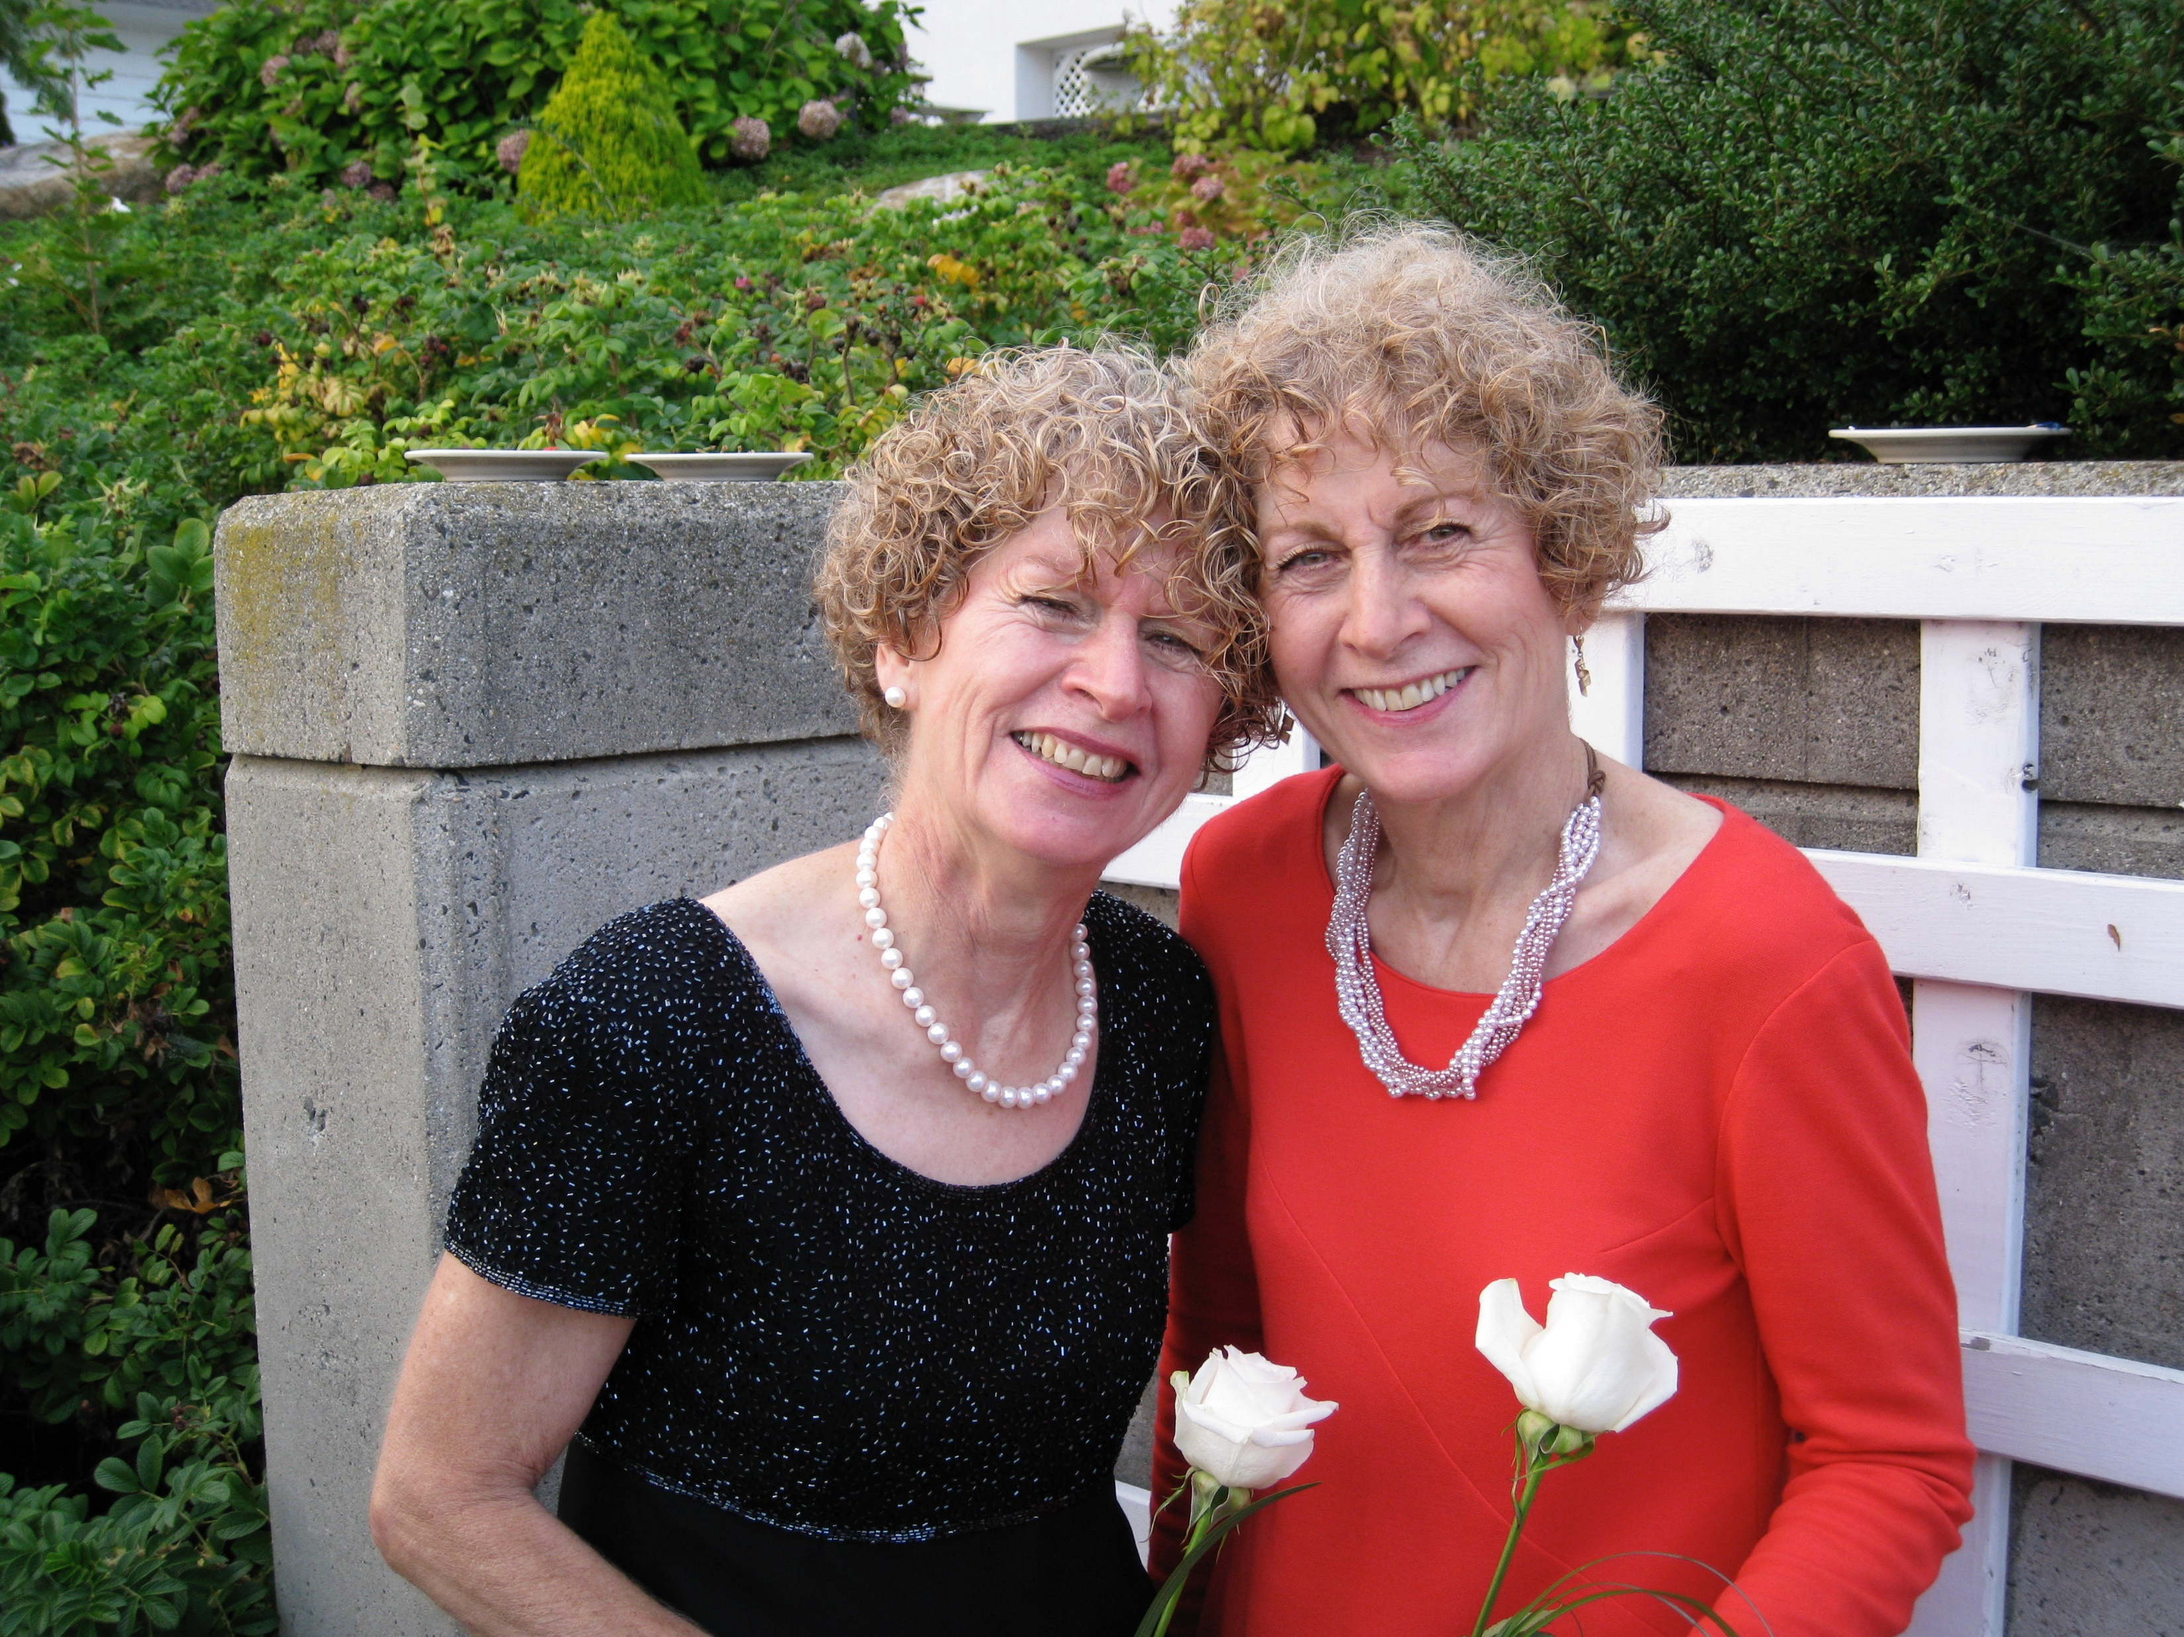
7/24/20 – Happy Birthday to the Twins

